Slide 1
REGIONAL TRAINING COURSE FOR CUSTOMS AUTHORITIES OF STATES PARTIES IN ASIA ON TECHNICAL ASPECTS OF THE TRANSFERS REGIME
OF THE CHEMICAL WEAPONS CONVENTION
New Delhi, India, 10-13 December 2012
Identification of Scheduled chemicals
in the Harmonized System
Daniel Cardozo
Consultant
Notes:
1

Slide 2
Objectives
By the end of this session participants should:
  Be familiar with the two WCO recommendations on the identification of scheduled chemicals in the Harmonized System
  Know which HS codes (in HS 2012) are applicable to commonly traded scheduled chemicals

Slide 3
Harmonized System (HS)
SECTION VI
Chapter 28: Inorganic Chemicals
Chapter 29: Organic chemicals
Chapter 30: Pharmaceutical products
Chapter 38: Miscellaneous chemicals products
The HS Structure
21 Sections
96 Chapters (2 digits)
Example:
Chapter 29: Organic chemicals
Heading 29.22: Oxygenated amino compounds
Sub-heading 2922.13: Triethanolamine and its salts
National Sub-heading 2922.13.XX: Triethanolamine
National Sub-heading 2922.13.99: Salts of Triethanolamine
6 Digits: International level
8 Digits Regional- National level
10-more Digits: National level

Slide 4
WCO Recommendation
The WCO issued a recommendation in 1996 on specific classification codes unique to CWC Scheduled Chemicals
Identifies six digit international level sub-headings under which Scheduled Chemicals are classified and recommends opening national subheadings (e.g. 8 or 10 digits in HS code) to identify key individual chemicals.

Slide 5
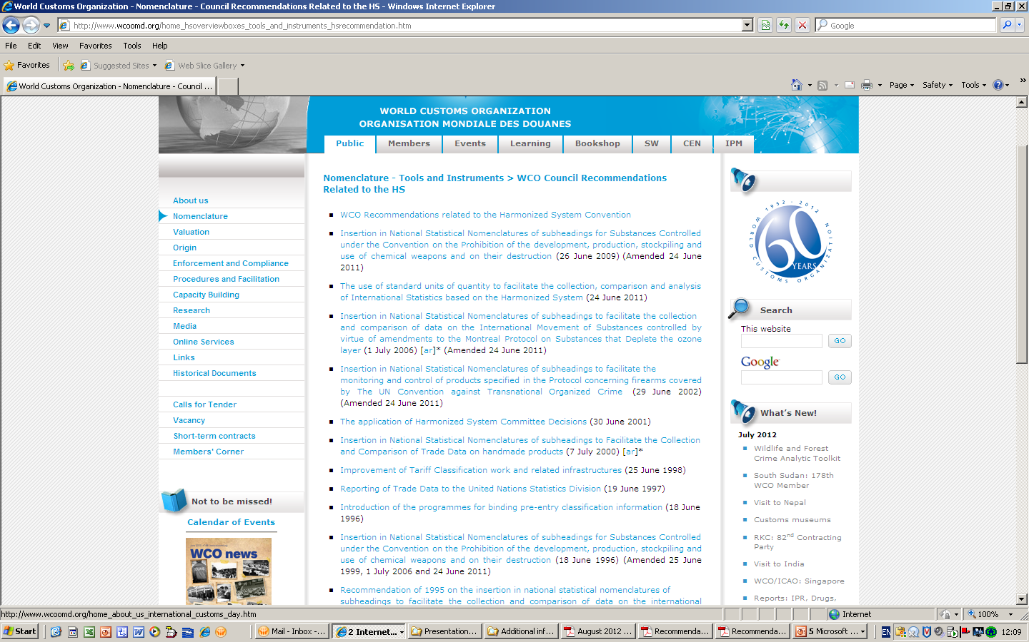
RECOMMENDATION OF THE WCO ON THE INSERTION IN NATIONAL STATISTICAL NOMENCLATURES OF SUBHEADINGS FOR SUBSTANCES CONTROLLED UNDER THE CWC
(18 June 1996, amended 25 June 1999, 1 July 2006 and 24 June 2011)
http://www.wcoomd.org/home_hsoverviewboxes_tools_and_instruments_hsrecommendation.htm
Notes:
5

Slide 6
Harmonized System (HS):
Relevant 2012 Subheadings
2811.19
2812.10
2853.00
2903.39
2904.90
2905.19
2918.19
2920.90
2921.19
2922.13
2922.19
2929.90
2930.90
2931.90*
2933.39
3002.90
3824.90
17 Subheadings
* 2931.00 in HS 2007

Slide 7
HS Codes 2012-WCO Recommendation
(Amended 24 June 2011)
Schedule 1 HS Sub-headings (CAS Registry number)
A. Toxic chemicals:
(1) O-Alkyl (<C10, incl. cycloalkyl) alkyl
(Me, Et, n-Pr or i-Pr)-phosphonofluoridates 2931.90
e.g. Sarin: O-Isopropyl methylphosphonofluoridate (107-44-8)
Soman: O-Pinacolyl methylphosphonofluoridate (96-64-0)
(2) O-Alkyl (<C10, incl. cycloalkyl) N,N-dialkyl 2931.90
(Me, Et, n-Pr or i-Pr) phosphoramidocyanidates
e.g. Tabun: O-Ethyl N,N-dimethyl
phosphoramidocyanidate (77-81-6)
(3) O-Alkyl (H or <C10, incl. cycloalkyl) S-2-dialkyl 2930.90
(Me, Et, n-Pr or i-Pr)-aminoethyl alkyl
(Me, Et, n-Pr or i-Pr) phosphonothiolates and
corresponding alkylated or protonated salts
e.g. VX: O-Ethyl S-2-diisopropylaminoethyl methyl phosphonothiolate (50782-69-9)

Slide 8
HS Sub-headings (CAS Registry number)
(4) Sulfur mustards: 2930.90
2-Chloroethylchloromethylsulfide (2625-76-5)
Mustard gas: Bis(2-chloroethyl)sulfide (505-60-2)
Bis(2-chloroethylthio)methane (63869-13-6)
Sesquimustard: 1,2-Bis(2-chloroethylthio)ethane (3563-36-8)
1,3-Bis(2-chloroethylthio)-n-propane (63905-10-2)
1,4-Bis(2-chloroethylthio)-n-butane (142868-93-7)
1,5-Bis(2-chloroethylthio)-n-pentane (142868-94-8)
Bis(2-chloroethylthiomethyl)ether (63918-90-1)
O-Mustard: Bis(2-chloroethylthioethyl)ether (63918-89-8)
(5) Lewisites: 2931.90
Lewisite 1: 2-Chlorovinyldichloroarsine (541-25-3)
Lewisite 2: Bis(2-chlorovinyl)chloroarsine (40334-69-8)
Lewisite 3: Tris(2-chlorovinyl)arsine (40334-70-1)
(6) Nitrogen mustards: 2921.19
HN1: Bis(2-chloroethyl)ethylamine (538-07-8)
HN2: Bis(2-chloroethyl)methylamine (51-75-2)
HN3: Tris(2-chloroethyl)amine (555-77-1)
(7) Saxitoxin 3002.90 (35523-89-8)
(8) Ricin 3002.90 (9009-86-3)

Slide 9
B. Precursors: HS Sub-headings (CAS Registry number)
(9) Alkyl (Me, Et, n-Pr or i-Pr) phosphonyldifluorides 2931.90
e.g. DF: Methylphosphonyldifluoride (676-99-3)
(10) O-Alkyl (H or <C10, incl. cycloalkyl) O-2-dialkyl
(Me, Et, n-Pr or i-Pr)-aminoethyl alkyl
(Me, Et, n-Pr or i-Pr) phosphonites and
corresponding alkylated or protonated salts 2931.90
e.g. QL: O-Ethyl O-2-diisopropylaminoethyl
methylphosphonite (57856-11-8)
(11) Chlorosarin: O-Isopropyl methylphosphonochloridat 2931.90 (1445-76-7)
(12) Chlorosoman: O-Pinacolyl methylphosphonochloridate 2931.90 (7040-57-5)

Slide 10
Schedule 2 (CAS Registry number)
A. Toxic chemicals: HS Sub-headings
(1) Amiton: O,O-Diethyl S-[2-(diethylamino)ethyl]
phosphorothiolate (78-53-5)
and corresponding alkylated or protonated salts 2930.90
(2) PFIB: 1,1,3,3,3-Pentafluoro-2-(trifluoromethyl)-1-propene 2903.39 (382-21-8)
(3) BZ: 3-Quinuclidinyl benzilate (*) 2933.39 (6581-06-2)

Slide 11
B. Precursors: HS Sub-heading (CAS Registry number)
(4) Chemicals, except for those listed in Schedule 1,
containing a phosphorus atom to which is bonded 2931.90
one methyl, ethyl or propyl (normal or iso) group
but not further carbon atoms, 2930.90
e.g Methylphosphonyl dichloride (676-97-1)
Dimethyl methylphosphonate (756-79-6)
Exemption: Fonofos: O-Ethyl S-phenyl
ethylphosphonothiolothionate (944-22-9)
(5) N,N-Dialkyl (Me, Et, n-Pr or i-Pr) phosphoramidic dihalides 2929.90
(6) Dialkyl (Me, Et, n-Pr or i-Pr) N,N-dialkyl
(Me, Et, n-Pr or i-Pr)-phosphoramidates 2929.90
(7) Arsenic trichloride 2812.10 (7784-34-1)
(8) 2,2-Diphenyl-2-hydroxyacetic acid 2918.19 (76-93-7)

Slide 12
HS Sub-heading (CAS Registry number)
(9) Quinuclidin-3-ol 2933.39 (1619-34-7)
(10) N,N-Dialkyl (Me, Et, n-Pr or i-Pr) aminoethyl-2-chlorides 2921.19
and corresponding protonated salts
(11) N,N-Dialkyl (Me, Et, n-Pr or i-Pr) aminoethane-2-ols 2922.19
and corresponding protonated salts
Exemptions: N,N-Dimethylaminoethanol (108-01-0)
and corresponding protonated salts
N,N-Diethylaminoethanol (100-37-8)
and corresponding protonated salts
(12) N,N-Dialkyl (Me, Et, n-Pr or i-Pr) aminoethane-2-thiols 2930.90
and corresponding protonated salts
(13) Thiodiglycol: Bis(2-hydroxyethyl)sulfide 2930.90 (111-48-8)
(14) Pinacolyl alcohol: 3,3-Dimethylbutan-2-ol 2905.19 (464-07-3)

Slide 13
Schedule 3 HS Sub-heading (CAS Registry number)
A. Toxic chemicals:
(1) Phosgene: Carbonyl dichloride 2812.10 (75-44-5)
(2) Cyanogen chloride 2853.00 (506-77-4)
(3) Hydrogen cyanide 2811.19 (74-90-8)
(4) Chloropicrin: Trichloronitromethane 2904.90 (76-06-2)

Slide 14
B. Precursors: HS Sub-heading (CAS Registry number)
(5) Phosphorus oxychloride 2812.10 (10025-87-3)
(6) Phosphorus trichloride 2812.10 (7719-12-2)
(7) Phosphorus pentachloride 2812.10 (10026-13-8)
(8) Trimethyl phosphite 2920.90 (121-45-9)
(9) Triethyl phosphite 2920.90 (122-52-1)
(10) Dimethyl phosphite 2920.90 (868-85-9)
(11) Diethyl phosphite 2920.90 (762-04-9)
(12) Sulfur monochloride 2812.10 (10025-67-9)
(13) Sulfur dichloride 2812.10 (10545-99-0)
(14) Thionyl chloride 2812.10 (7719-09-7)
(15) Ethyldiethanolamine 2922.19 (139-87-7)
(16) Methyldiethanolamine 2922.19 (105-59-9)
(17) Triethanolamine 2922.13 (102-71-6)

Slide 15
ANY SCHEDULE MIXTURES:
HS Sub-heading 3824.90

Slide 16
CHANGES TO THE WCO’s RECOMMENDATION
Original recommendation consider too complex – limited adoption
New Recommendation based on 34 of the 35 most traded CWC chemicals was approved unanimously in 41st Session of the HS Committee, March 2008.
  - Classification of 1 additional chemical still to be considered by the Scientific Sub-Committee
It runs in parallel to Old Recommendation (was not revoked)
Approved by the Customs Co-Operation Council: 26 June 2009 (amended 24 June 2011)
Notes:
16
16

Slide 17
MOST TRADED CHEMICALS
Criteria for selection:
Worldwide trade > 1 tonne (1,000 kg)/year in any of the previous 5 years
Notes:
17

Slide 18
No | Sched | CAS | Chemical name | HS 2012
1 | 2B04 | 170836-68-7 | Mixture of CAS RN 41203-81-0 and CAS RN 42595-45-9 | 3824.90
2 | 2B04 | 18755-43-6 | Dimethyl propylphosphonate | 2931.90
3 | 2B04 | 41203-81-0 | (5-Ethyl-2-methyl-2-oxido-1,3,2-dioxaphosphinan-5-yl) methyl methyl methylphosphonate | 2931.90
4 | 2B04 | 42595-45-9 | Bis[(5-ethyl-2-methyl-2-oxido-1,3,2-dioxaphosphinan-5-yl)methyl] methylphosphonate | 2931.90
5 | 2B04 | 68957-94-8 | 2,4,6-Tripropyl-1,3,5,2,4,6-trioxatriphosphinane 2,4,6-trioxide | 2931.90
6 | 2B04 | 70715-06-9 | Mixture of Dimethyl methylphosphonate, Oxirane and Phosphorus oxide(P2O5) | 3824.90
7 | 2B04 | 756-79-6 | Dimethyl methylphosphonate | 2931.90
8 | 2B04 | 78-38-6 | Diethyl ethylphosphonate | 2931.90
9 | 2B04 | 84402-58-4 | Mixture: 50% Methylphosphonic acid / 50% (Aminoiminomethyl)urea | 2931.90
10 | 2B04 | 84962-98-1 | Sodium 3-(trihydroxysilyl)propyl methylphosphonate | 2931.90
11 | 2B08 | 76-93-7 | 2,2-Diphenyl-2-hydroxyacetic acid | 2918.19
12 | 2B10 | 4261-68-1 | 2-(N,N-Diisopropylamino)ethylchloride hydrochloride | 2921.19
13 | 2B10 | 4584-46-7 | 2-(N,N-Dimethylamino)ethylchloride hydrochloride | 2921.19
14 | 2B10 | 869-24-9 | 2-(N,N-Diethylamino)ethylchloride hydrochloride | 2921.19
15 | 2B11 | 96-80-0 | 2-(N,N-Diisopropylamino)ethanol | 2922.19
16 | 2B12 | 100-38-9 | 2-(N,N-Diethylamino)ethanethiol | 2930.90
17 | 2B13 | 111-48-8 | Bis(2-hydroxyethyl)sulfide | 2930.90
18 | 2B04 | 294675-51-7 | Phosphonic acid, methyl-, polyglycol ester | 2931.90 ←
← Classification has not been examined by the HS Committee – not included in recommendation

Slide 19
No | Sched | CAS | Chemical name | HS
19 | 3A01 | 75-44-5 | Carbonyl dichloride | 2812.10
20 | 3A02 | 506-77-4 | Cyanogen chloride | 2853.00
21 | 3A03 | 74-90-8 | Hydrogen cyanide | 2811.19
22 | 3A04 | 76-06-2 | Trichloronitromethane | 2904.90
23 | 3B05 | 10025-87-3 | Phosphorous oxychloride | 2812.10
24 | 3B06 | 7719-12-2 | Phosphorous trichloride | 2812.10
25 | 3B07 | 10026-13-8 | Phosphorous pentachloride | 2812.10
26 | 3B08 | 121-45-9 | Trimethyl phosphite | 2920.90
27 | 3B09 | 122-52-1 | Triethyl phosphite | 2920.90
28 | 3B10 | 868-85-9 | Dimethyl phosphite | 2920.90
29 | 3B11 | 762-04-9 | Diethyl phosphite | 2920.90
30 | 3B12 | 10025-67-9 | Sulfur monochloride | 2812.10
31 | 3B13 | 10545-99-0 | Sulfur dichloride | 2812.10
32 | 3B14 | 7719-09-7 | Thionyl chloride | 2812.10
33 | 3B15 | 139-87-7 | Ethyldiethanolamine | 2922.19
34 | 3B16 | 105-59-9 | Methyldiethanolamine | 2922.19
35 | 3B17 | 102-71-6 | Triethanolamine | 2922.13

Slide 20
Harmonized System (HS):
Relevant 2012 Subheadings
2811.19
2812.10
2853.00
2903.39
2904.90
2905.19
2918.19
2920.90
2921.19
2922.13
2922.19
2929.90
2930.90
2931.90*
2933.39
3002.90
3824.90
12 Subheadings
* 2931.00 in HS 2007
Notes:
20

Slide 21
COVERAGE OF THE SIMPLIFIED RECOMMENDATION
YEAR | 2002 | 2003 | 2004 | 2005 | 2006 | 2007 | 2008
% S2 TRANSFERS COVERED (18 Chemicals) | 99.98 % | 100 % | 99.98 % | 99.90 % | 99.98 % | 99.97 % | 99.76 %
% S2 TRANSFERS COVERED (17 Chemicals) | 99.84 % | 99.85 % | 99.71% | 99.73 % | 99.73% | 99.65 % | 99.54%
Difference | 0.14 % | 0.15 % | 0.27 % | 0.17 % | 0.25 % | 0.32 % | 0.22 %
% S3 TRANSFERS COVERED | 100 % | 100 % | 100 % | 100 % | 100 % | 100 % | 100 %
Notes:
21
Coverage based on declared trade
Trade patterns may change in the future
21

Slide 22
RECOMMENDATION OF THE CUSTOMS CO-OPERATION COUNCIL ON THE INSERTION IN NATIONAL STATISTICAL NOMENCLATURES OF SUBHEADINGS FOR SUBSTANCES CONTROLLED UNDER THE CONVENTION ON THE PROHIBITION OF THE DEVELOPMENT, PRODUCTION, STOCKPILING AND USE OF CHEMICAL WEAPONS AND ON THEIR DESTRUCTION
(AMENDED 24 JUNE 2011)
THE CUSTOMS CO-OPERATION COUNCIL, CONSIDERING the urgent need to control and monitor international trade in substances capable of being used as chemical weapons or for the production of chemical weapons,
NOTING the request of the Preparatory Commission for the Organization for the Prohibition of Chemical Weapons to introduce specific subheadings in the Harmonized System in order to facilitate the collection and comparison of data on the international movement of substances controlled under the Convention on the Prohibition of the Development, Production, Stockpiling and Use of Chemical Weapons and on their Destruction,
RECOGNIZING that amendments to the Harmonized System Convention cannot be implemented for several years,
RECOGNIZING the difficulties of the Member administrations and Contracting Parties to the Harmonized System Convention to administer the additional subdivisions set out in the Recommendation of 18 June 1996, as amended on 25 June 1999 and 1 July 2006,

Slide 23
RECOMMENDATION (2)
RECOGNIZING that from all the substances subject to the Convention on the Prohibition of the Development, Production, Stockpiling and Use of Chemical Weapons and on their Destruction, the collection and comparison of data on the international movement of the substances that are commonly traded is of primary interest,
NOTING that Member Administrations and Contracting Parties to the Harmonized System Convention which have not yet accepted the Recommendation of 18 June 1996, as amended on 25 June 1999 and 1 July 2006, may wish to accept and implement provisions requiring a less complex structure in their statistical nomenclature,
RECOMMENDS that Member administrations and Contracting Parties to the Harmonized System Convention take all appropriate action to insert the additional subdivisions set out in the Annex to this Recommendation in their statistical nomenclatures in such a manner as indicated in the Notes therein, as soon as possible, and
REQUESTS Member administrations and Contracting Parties to the Harmonized System Convention to notify the Secretary General of their acceptance of this Recommendation and the date of its application and, where applicable, to specify which items are omitted pursuant to Note 1 in the Annex and which items are grouped pursuant to Note 2 in the Annex.

Slide 24
ANNEX TO THE RECOMMENDATION OF THE CUSTOMS CO-OPERATION COUNCIL ON THE INSERTION IN NATIONAL STATISTICAL NOMENCLATURES OF SUBHEADINGS FOR SUBSTANCES CONTROLLED UNDER THE CONVENTION ON THE PROHIBITION OF THE DEVELOPMENT, PRODUCTION, STOCKPILING AND USE OF CHEMICAL WEAPONS AND ON THEIR DESTRUCTION
(AMENDED 24 JUNE 2011)
NOTES
1. Items with "*" are optional.
2. Two or more items in the same HS subheading may be grouped together as a single
subdivision.
Subheading 2811.19
- - - Hydrogen cyanide
Subheading 2812.10
- - - Carbonyl dichloride (phosgene)
- - - Phosphorus oxychloride
- - - Phosphorus trichloride
- - - Phosphorus pentachloride
- - - Sulphur monochloride
- - - Sulphur dichloride
- - - Thionyl chloride

Slide 25
ANNEX (2)
Subheading 2853.00
- - - Cyanogen chloride
Subheading 2904.90
- - - Trichloronitromethane (chloropicrin)
Subheading 2918.19
- - - 2,2-Diphenyl-2-hydroxyacetic acid (benzilic acid) *
Subheading 2920.90
- - - Trimethyl phosphite
- - - Triethyl phosphite
- - - Dimethyl phosphite
- - Diethyl phosphite
Subheading 2921.19
- - - 2-(N,N-Diethylamino)ethylchloride hydrochloride *
- - - 2-(N,N-Diisopropylamino)ethylchloride hydrochloride *
- - 2-(N,N-Dimethylamino)ethylchloride hydrochloride *
Subheading 2922.13
- - - Triethanolamine

Slide 26
ANNEX (3)
Subheading 2922.19
- - - Ethyldiethanolamine
- - - Methyldiethanolamine
- - - 2-(N,N-Diisopropylamino)ethanol *
Subheading 2930.90
- - - 2-(N,N-Diethylamino)ethanethiol *
- - - Bis(2-hydroxyethyl)sulfide *
Subheading 2931.90
- - - (5-Ethyl-2-methyl-2-oxido-1,3,2-dioxaphosphinan-5-yl)methyl methyl methylphosphonate *
- - - Bis[(5-ethyl-2-methyl-2-oxido-1,3,2-dioxaphosphinan-5-yl)methyl] methylphosphonate *
- - - 2,4,6-Tripropyl-1,3,5,2,4,6-trioxatriphosphinane 2,4,6-trioxide *
- - - Dimethyl methylphosphonate *
- - - Dimethyl propylphosphonate *
- - - Diethyl ethylphosphonate *
- - - Sodium 3-(trihydroxysilyl)propyl methylphosphonate *
- - - Mixtures consisting mainly of methylphosphonic acid and (aminoiminomethyl)urea (in
the ratio 50:50) *

Slide 27
ANNEX (4)
Subheading 3824.90
- - - Mixtures consisting mainly of (5-ethyl-2-methyl-2-oxido-1,3,2-dioxaphosphinan-5-
yl)methyl methyl methylphosphonate and bis[(5-ethyl-2-methyl-2-oxido-1,3,2-
dioxaphosphinan-5-yl)methyl] methylphosphonate *
- - - Mixtures consisting mainly of dimethyl methylphosphonate, oxirane and phosphorus
oxide (P2O5) *

Slide 28
Status of Implementation of the WCO’s Recommendation
Albania, Algeria
Angola, Andorra
Argentina
Australia, Azerbaijan
Bolivia
Brazil
Canada
Cape Verde
Chile
China
Colombia
Croatia
Cuba
Dominican Republic
El Salvador
Egypt
Ethiopia
India
Iran
Japan
Rep of Korea
Madagascar
New Zealand
Peru
Qatar
Russia, Rwanda
Senegal
Serbia
Sri Lanka
South Africa
Tunisia, Turkey
Ukraine
Uruguay
USA and EU (27)
According to WCO: 66 SP to the WCO formally adopted the Recommendations as of September 2012. In October 2010 Costa Rica, Guatemala, Honduras, and Nicaragua notified the OPCW the adoption of the Recommendation, increasing the number to 69 SPs but have not notified the WCO. Including OPCW survey, around 71 SPs adopted the Recommendations
28
Notes:
28

Slide 29
Next Steps for the OPCW
Possible addition of remaining chemical (Phosphonic acid, methyl-, polyglycol ester) to the recommendation at a later date
Continual monitoring of the trade in Scheduled chemicals to ensure the recommendation remains current
Notes:
29

Slide 30
Next Steps for the OPCW (2)
Both old and new recommendations are based on countries opening national subheadings – still no 6 digit codes at the international level for any scheduled chemicals
Exploring possibility of an amendment to the HS to have 6 digit international codes allocated to key CWC chemicals as has been done for the Montreal Protocol – this would be a long term project and probably would not come into effect until 2017 at the earliest.
Notes:
30

Slide 31
Proposed Steps for States Parties
States Parties are strongly encouraged to adopt 1 of the 2 recommendations if they have not done so
States Parties should take account of recent amendments to recommendations due to introduction of HS 2012 if not already done so
National Authorities, licensing authorities, customs authorities and any other relevant government agencies should work closely together to ensure that all relevant trade in Scheduled chemicals is covered by the subheadings adopted (particularly if the original recommendation is adopted)
Should consider joint training with all relevant government agencies in commodity identification
Notes:
31

Slide 32
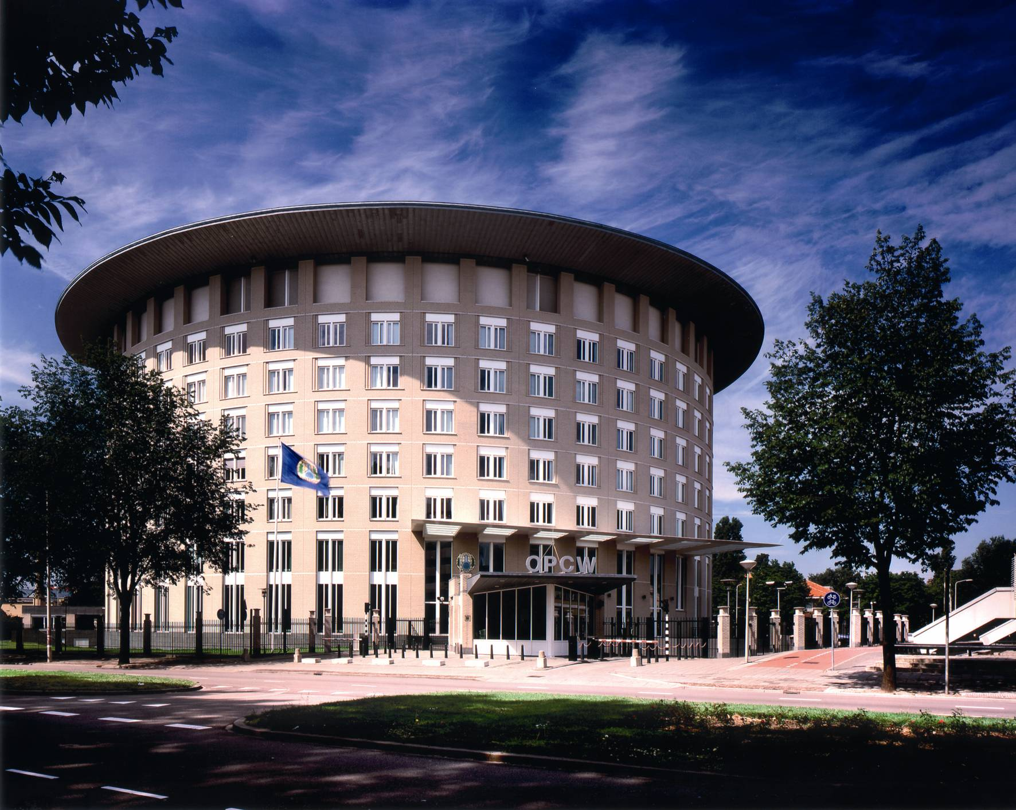
Thank you
Any Questions?
32

