Slide 1
Guidance for Safe and Secure Transport of Hazardous Chemicals by Road
A User’s Guide” Implementing Indicative Guidelines for Safe and Secure Transport of Hazardous Chemicals by Road
Notes:
Welcome.
This training provides an overview of the OPCW Indicative Guidelines for the Safe and Secure Transport of Hazardous Chemicals by Road.
We’ll explore key principles, roles of stakeholders, and best practices to ensure that the road transport of hazardous chemicals is done in safe and secure manner.

Slide 2
© Organisation for the Prohibition of Chemical Weapons, The Hague, the Netherlands, 2025
No use of this document may be made for any commercial purpose whatsoever without prior permission in writing from the OPCW.
The views expressed in this document or any part thereof do not necessarily represent those of the OPCW or its Member States. The OPCW accepts no responsibility for the content of this document or the consequences of any actions taken on the basis of the information herein provided.
This document contains links and references to third-party websites. The linked websites are not under control of the OPCW, and the OPCW is not responsible for the content of any linked websites, or any link contained therein. The inclusion of a link or reference does not imply an endorsement of the linked website by the OPCW.
Mention of the names of firms and commercial products does not imply endorsement by the OPCW.
The use of general descriptive names, registered names, trademarks, etc. does not imply, even in the absence of a specific statement, that such names are exempt from the relevant protective laws and regulations and therefore free for general use.
Notes:
Before we start, please note that the material presented here is the property of the OPCW. It is intended for educational and professional use only and may not be used for any commercial purpose without written permission.
The examples and scenarios we’ll discuss are illustrative. They do not necessarily reflect the views of the OPCW or its Member States.

Slide 3
Course Overview
Course Objectives
Introduction to Concepts and Terms
Transport Case Studies for Release and Theft
Conceptualisation of Supply Chain
Risk Management Concepts for Transport
Introduction to Cyber Security Risks
Role-Specific Guidance for the Stages of Transport
Notes:
This training is organised into several sections:
Sections One and Two introduce the course objects, key concepts and terminology from the OPCW Indicative Guidelines for the Safe and Secure Transport of Hazardous Chemicals by Road.
Section Three reviews known incidents and lessons learned for safe and secure transport of hazardous goods.
Section Four helps to understand and define their roles within the chemical supply chain.
Then, Section Five focuses on the core principles of risk management in the transport of hazardous chemicals.
Finally, Section Six is an introduction to the topic of emerging cyber security risks and Section Seven provides role-specific guidance for each stage of transport.

Slide 4
Course Objectives
By the end of this course, you will:
Be introduced to key concepts and terms from the OPCW Indicative Guidelines for Safe and Secure Transport of Hazardous Chemicals by Road;
Be able to identify your role and responsibilities in the transport of hazardous chemicals;
Be familiar with industry recommended best practices for the safe and secure transport of hazardous chemicals.
Notes:
By the end of this course, you will:
-Be introduced to key concepts and terms from the OPCW Indicative Guidelines for the Safe and Secure Transport of Hazardous Chemicals by Road;
-Be able to identify your role and responsibilities within the transport of hazardous chemicals process; and
-Be familiar with industry-recommended best practices for the safe and secure transport of hazardous chemicals.

Slide 5
Introduction to Concepts and Terms
Notes:
The chemical industry plays a major role in the global economy, as most manufactured products rely on industrial chemical processes. [1] Between 2000 and 2017, global chemical production capacity nearly doubled, increasing from 1.2 to 2.3 billion tonnes. Sales of chemical products (excluding pharmaceuticals) are also projected to grow substantially from 2017 to 2030. [2]
While this growth benefits the global economy, the transfer of chemicals throughout the supply chain requires increasingly robust safety and security measures to protect businesses, workers, and surrounding communities.
References:
[1] International Council of Chemical Associations (ICCA), Oxford Economics, The Global Chemical Industry: Catalyzing Growth and Addressing Our World’s Sustainability Challenges, 7, available at: https://icca-chem.org/wp-content/uploads/2020/10/Catalyzing-Growth-and-Addressing-Our-Worlds-Sustainability-Challenges-Report.pdf.
[2] United Nations Environmental Programme (UNEP), Global Chemicals Outlook II: From Legacies to Innovative Solutions, Synthesis Report 2019, 28, available at: https://www.unep.org/resources/report/global-chemicals-outlook-ii-legacies-innovative-solutions.

Slide 6
Objectives
By the end of this section, you will be aware of:
The relationship between safe and secure transport of hazardous chemicals by road;
Definitions and terms used in OPCW Indicative Guidelines for Safe and Secure Transport of Hazardous Chemicals by Road;
The stages of journey management.
Notes:
In this section, we will introduce the relationship between the safe and secure transport of hazardous goods, along with the key definitions used throughout the guidelines.
This introduction will also cover the phases of journey management. You will then be able to apply these guidelines to your daily activities.

Slide 7


Safe and Secure Chemical Transport
Chemical Security
Measures that prevent the intentional misuse, release, or theft of hazardous chemicals and - should those measures fail - mitigate the impact of any consequences.
Chemical Safety
Measures that prevent the accidental release of hazardous chemicals and - should prevention fail - mitigate the potential impact of any ensuing consequences on people, the environment, and property.
Notes:
Chemical transport has historically focused on unintentional safety accidents. When incidents are intentional, they become a security concern. Today, responsible chemical transport addresses both safety and security aspects.

Slide 8





Chemical Transport: Start to Finish
Origin
Destination
Environmental Concern Area
Safety Concern Area
Security Concern Area
Preparation
Loading
Driving
Stop / Break
Driving
Unloading
Notes:
Safe and secure transport begins before a shipment leaves a facility and continues after it is delivered.
Transport routes may present safety and security concerns, for example when passing through populated or high-crime areas.

Slide 9
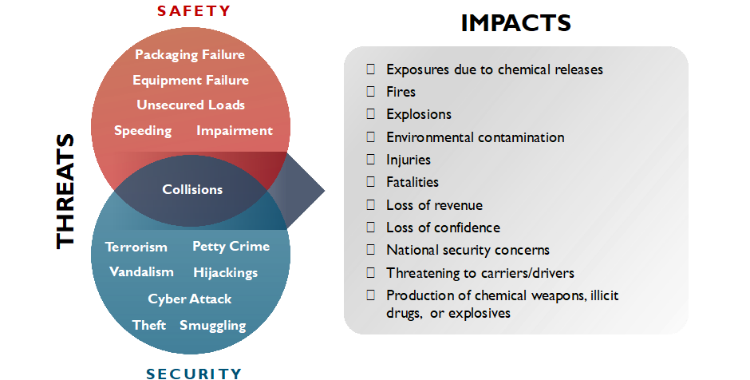
Relationship between Safety and Security
Notes:
Safety scenarios can be caused by factors such as equipment failure, unsecured loads, changing weather conditions, speeding, or driver impairment.
Security scenarios result from attacks by terrorists, petty criminals, or other actors who may steal, vandalise, hijack, or cyber‑attack vehicles or transport systems. Both safety and security incidents may involve collisions with other vehicles or objects.
Collectively, these incidents can lead to a range of negative impacts, including the release or loss of chemicals, resulting in harmful exposure to populations and the environment, injuries, deaths, national security concerns, and business impacts. Managing safety and security may involve similar or complementary measures, but in some cases, approaches may differ.
The OPCW guidelines serve as a resource for organizations, providing advice on operational best practices and questions that can assist people in developing risk-management systems.

Slide 10
Transportation Roles
Haulier
Warehouse
Carrier
Manufacturer
Logistics Provider
Tank Farm
Driver
Warehouse
Sender
Warehouse
Receiver
End-user
Distributor
Wholesaler
Notes:
To use the OPCW guidelines effectively, it is important to understand the role, or potentially multiple roles, you play during the transport process:
Driver: The individual authorised to drive the vehicle and operate its equipment.
Logistics Provider: The company or contractor responsible for overseeing the shipment. In the UN Recommendations on the Transport of Dangerous Goods (UNRTDG), this is defined as a “carrier.” This category also includes independent drivers who own and operate their own vehicles.
Sender: The company or institution from which the chemical shipment originates. In the UNRTDG, this is defined as the “consignor” and is commonly referred to as the “shipper.”
- Receiver: The company or institution that receives the chemical shipment from the sender or logistics provider. In the UNRTDG, this is defined as the “consignee” and is commonly referred to as the “end user.”

Slide 11





Stages of the transport process
PREPARATION
LOADING
DRIVING
STOPS/BREAKS
UNLOADING
hazard identification
packing
labelling and marking
fulfilling documentation requirements
route selection
transferring hazardous chemicals:
tank to tank
forklift to truck
truck to truck
qualified drivers
appropriate packaging
approved routes
follow safety and security plans
Planned (mandatory) or unplanned stops
planned (mandatory) or unplanned stops
Notes:
The OPCW guidelines provides advice for stakeholders, organised according to the stages inherent in the transport process depicted here.
Preparation is an important stage in preventing safety and security incidents. [1] This step includes hazard identification, packing, labelling and marking, fulfilling documentation requirements, and route selection. All parties should understand the risks involved with the goods being transported and communicate relevant information to ensure that stakeholders have the necessary skills and training. The instructions and questions below can help stakeholders maximise their preparations for transport.
Loading and Unloading: The processes of loading and unloading chemicals share similar risks and risk-management principles. [1], [2], [3], [4], [5] These activities may involve transferring hazardous chemicals from tank to tank, from forklift to truck, or from truck to truck. While transferring the chemicals may be a small part of the overall process, it can pose increased safety and security risks. Proper preparation can help manage these risks, though additional considerations may be needed for these types types of trans-shipments. Recipients may benefit from following the instructions provided in this section.
Driving: Hazardous chemicals in motion present distinct safety and security risks. These risks can be mitigated through appropriate controls, including qualified drivers, proper packaging, and approved routes. Drivers should remain alert and follow to established safety and security plans.
Stops/Breaks: Drivers may need to make planned (mandatory) or unplanned stops (e.g., due to road closures or other unforeseen events). Whenever possible, vehicles should be parked in locations suitable for hazardous materials. Parked or stopped vehicles present different safety and security risks. Driver training on risks, as well as instruction on selecting appropriate controls (e.g., locks, GPS devices), can prevent theft and/ or release of hazardous materials. Drivers should be trained, alert, and ready to execute contingency plans.
References
- Preparation
[1] EUR-Lex, Council Directive 95/50/EC of 6 October 1995 on uniform procedures for checks in the transport of dangerous goods by road, EUR-Lex - 31995L0050 - EN - EUR-Lex. Available at: https://eur-lex.europa.eu/legal-content/EN/TXT/?uri=CELEX%3A31995L0050
- Loading and Unloading
[1] CEFIC, Best Practice Guidelines for Safe (Un)Loading of Road Freight Vehicles: Covering Technical, Behavioural and Organisational Aspects, Issue 1, Dec. 2013, Corrigendum Sept. 2021. Available at: https://cefic.org/app/uploads/2021/09/Best-practice-guidelines-for-safe-Un-Loading-of-road-freight-vehicles-Corrigendum-2021-GUIDELINES-ROAD.pdf
[2] CEFIC, SULID (Site (Un)Loading Document) Guidance. Available at: https://cefic.org/guidance/transport-and-logistics/sulid-site-unloading-document
[3] Chemical Business Association, Semi Bulk Discharge Procedure: Recommended Code of Practice, Issue no. 5 (Draft), Revised Aug. 2018. Available at: http://www.chemical.org.uk/wp-content/uploads/2018/12/Semi-Bulk-Discharge-Procedure-Recommended-Code-of-Procedure-August-2018.pdf
[4] Chemical Industries Association, Tanker Coupling Code of Conduct for Sodium Hypochlorite, Issue no. 2, June 2018. Available at: http://www.chemical.org.uk/wp-content/uploads/2020/01/Sodium-Hypochlorite-Tanker-Couplings-Code-Tripartite-v2-June-2018.pdf
[5] Chemical Business Association, Handling, Storage and Distribution of Packaged Hydrofluoric Acid, Version 3.1 Draft, March 2021. Available at: https://www.chemical.org.uk/wp-content/uploads/2021/04/HF-guidance-version-3-1-March-2021.pdf

Slide 12
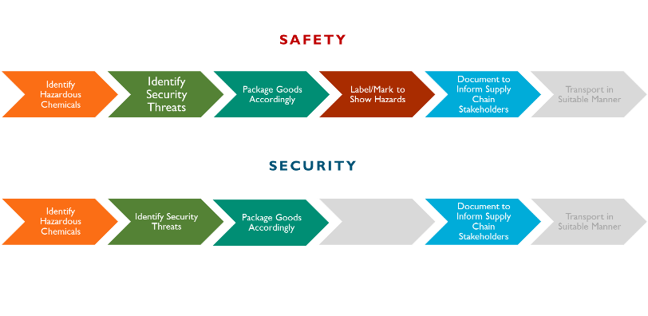
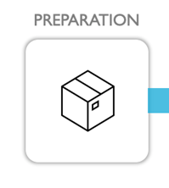
Transport: Plan and Preparation
Notes:
Chapter 7 of the OPCW guidelines provides advice on how the parties involved should plan and prepare for transport.
Preparations should include the identification of hazardous chemicals and the assessment of safety and security threats.
Goods should be packaged and labelled in accordance with regulatory requirements and proportionate to the risks involved.
Finally, all relevant and specific documentation should be prepared to inform relevant stakeholders in the supply chain about the associated risks.

Slide 13
Release and Theft Transport Case Studies

Slide 14
Objectives
By the end of this section, you will:
Be aware of previous incidents in the transport of hazardous chemicals;
Relate previous incidents to your facility.
Notes:
By the end of this section, you will be aware of previous incidents involving the transport of hazardous chemicals, and you will be able to relate these examples to your facility.

Slide 15

Fixed Site Transit
Loading
Scenario:
Workers dropped two bottles of a toxic industrial chemical from a loading dock as they were transferring them to a truck. Approximately 4 litres of the chemical were spilled, and 300 to 400 people were evacuated from nearby buildings.
Accidental Release
Notes:
Source: Spartan Daily, Two men hospitalised after chemical spill at SJSU, 2010. Available at: https://scholarworks.sjsu.edu/cgi/viewcontent.cgi?referer=&httpsredir=1&article=6769&context=spartandaily

Slide 16
Fixed Site Transit
Loading
Scenario:
Tamper-evident seals of two trailers were cut, which resulted in an environmental release of 63,000 litres of a volatile, flammable liquid. The incident required environmental sampling, and it was determined that soil excavation and replacement were necessary.
Intentional Release
Notes:
Source: Pipeline and Hazardous Materials Safety Administration (PHMSA), Incident Report I-2013010439. Available at: https://www.phmsa.dot.gov/hazmat-program-management-data-and-statistics/data-operations/incident-statistics -> Hazmat Incident Report Search Tool -> Report Number: 2013010439

Slide 17
Fixed Site Transit
Loading
Scenario:
A truck with 225 kilograms of strong acid was stolen while parked at a chemical distribution company. Motivation for the theft is unknown.
Theft

Slide 18
Road Stop
Stops and Breaks
Scenario:
A tanker truck spilled over 20,000 litres of a strong acid at a truck stop after a valve on the tanker broke. Acid flowed into a ditch on the side of the highway.
Do you know or have an example of a chemical release or theft at a fixed site?
Accidental Release
Notes:
Moving to road stops: in this case, a tanker truck spilled more than 20,000 litres of strong acid at a rest area after a valve broke.
The acid flowed into a roadside ditch.
Source: Associated Press, Highway in Indiana, Michigan reopens after chemical spill. Available at: https://apnews.com/article/indiana-michigan-chemical-spills-22d301a337fe170001a3e61fcd3dc888

Slide 19
Road Stop
Stops and Breaks
Scenario:
Emergency responders discovered that a trailer containing a toxic industrial chemical was leaking. The driver was notified and donned personal protective equipment (PPE) to tighten the equipment and stop the leak. Tampering was suspected.
Do you know or have an example of a chemical release or theft at a fixed site?
Intentional Release
Notes:
Source: Pipeline and Hazardous Materials Safety Administration (PHMSA), Incident Report. Available at: https://www.phmsa.dot.gov/hazmat-program-management-data-and-statistics/data-operations/incident-statistics -> Hazmat Incident Report Search Tool -> Report Number: 2018090077

Slide 20
Road Stop
Stops and Breaks
Scenario:
A transit van was stolen while it was parked on the street; it was found abandoned several days later. Some of the missing unaccounted cargo included a weaponisable rodenticide.
Do you know or have an example of a chemical release or theft at a fixed site?
Theft
Notes:
Source: BBC News, Lancashire chemical spill: Hundreds evacuated after leak, 2020. Available at: https://www.bbc.com/news/uk-england-lancashire-53261147

Slide 21
In-Transit/
Detour/Choke Point
Driving
Scenario:
A truck spilled approximately 800 litres of corrosive chemical on a bridge after its load shifted, resulting in a punctured container. The bridge was temporarily closed to allow responders to neutralize the chemical.
Accidental Release
Notes:
Source: The Gleaner, Chemical leak causes extended roadway closures; no injuries reported, 3 September 2021. Available at: https://www.thegleaner.com/story/news/2021/09/03/chemical-leak-causes-extended-roadway-closures-no-injuries-reported/5712335001/

Slide 22
In-Transit/
Detour/Choke Point
Driving
Scenario:
Upon arrival to the delivery site, a driver noticed that the trailer had been struck with a bullet. The bullet pierced the tank, resulting in leakage of gasoline onto the concrete.
Intentional Release
Notes:
Source: Pipeline and Hazardous Materials Safety Administration (PHMSA), Incident Report. Available at: https://www.phmsa.dot.gov/hazmat-program-management-data-and-statistics/data-operations/incident-statistics -> Hazmat Incident Report Search Tool -> Report Number: 2018070192

Slide 23
In-Transit/
Detour/Choke Point
Driving
Scenario:
While in transit to a mining customer, a truck carrying 10 tons of a toxic chemical was stolen. The thieves distracted the driver by staging a disabled vehicle on the side of the road. The truck was found empty; the chemical was recovered elsewhere. Motivation for the heist remains unknown.
Theft
Notes:
Source: Sandia National Laboratories, Cyanide Theft Case Study, SAND2016-3784 TR_HN.

Slide 24
Unloading
Unloading
Scenario:
A release of a toxic gas occurred when a delivery truck inadvertently connected to a tank containing incompatible material. The plume of gas generated resulted in a shelter-in-place order for thousands of residents and at least 120 individuals seeking medical attention.
Accidental Release
Notes:
Source: U.S. Chemical Safety and Hazard Investigation Board (CSB), MGPI Processing Inc Toxic Chemical Release. Available at: MGPI Processing, Inc. Toxic Chemical Release | CSB

Slide 25
Unloading
Unloading
Scenario:
A hose on a portable 110,000-litre tank of a toxic industrial chemical was intentionally cut. This resulted in a release of gas that hospitalised a police officer and the closure of a highway for 30 minutes.
Intentional Release
Notes:
Source: U.S. Environmental Protection Agency (EPA), Chemical Safety Alert, 2013. Available at: https://www.epa.gov/sites/default/files/2013-11/documents/csalert.pdf

Slide 26
Unloading
Unloading
Scenario:
Twenty-two different chemicals were stolen while awaiting transfer at an industrial park. Drivers and custodial staff were among the individuals arrested as part of the theft.
Theft
Notes:
Source: Times of India, Chemical theft racket busted in Vapi; 12 held, 11 November 2015. Available at: Chemical theft racket busted in Vapi, 12 held | Surat News - Times of India

Slide 27
Conceptualisation of Supply Chain

Slide 28
Objectives
By the end of this section, you will:
Identify if you are:
“sender”,
“driver”,
“logistics provider”
Notes:
By the end of this section, you’ll be able to identify your role, whether you are a sender, logistics provider, or driver, within the broader chemical supply chain.

Slide 29
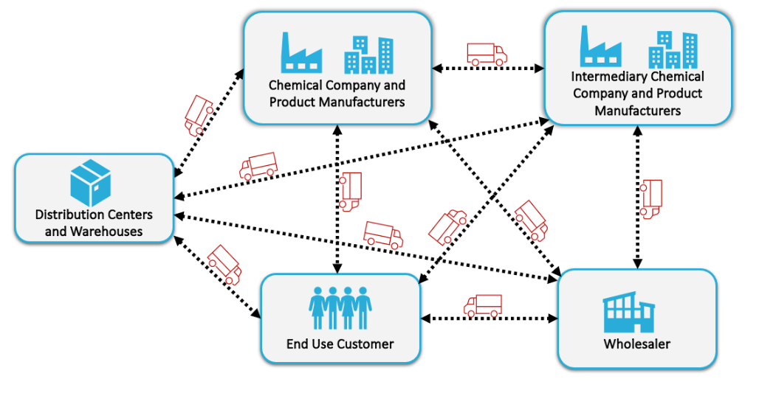
Chemical Supply Chain
Notes:
Chemical manufacturing begins with raw material suppliers and then moves through various manufacturers and distribution centres before finished products are delivered to end-use customers.
All stakeholders throughout the supply chain have a role in securing chemicals during transport and may therefore consider developing transport risk management programmes.
Stakeholders can include chemical extraction companies, chemical manufacturing companies, distribution companies, shippers, carriers, logistics service providers, and security professionals.
It is important to clearly identify your role in the supply chain.

Slide 30
Activity: Identifying Your Role(s)
In your group:
Describe your current roles and responsibilities when transporting hazardous chemicals
Sender
Logistics
Provider
Driver
Notes:
Within the OPCW guidelines, advice is given based on the role of the person or organisation involved in the transport of hazardous chemicals. To make best use of the guide, it is important to identify your role.
Instructor Notes:
Instructors will facilitate a group discussion to identify the role of each organisation or facility. This activity may be implemented in small or large groups, with representatives from one or multiple facilities. The outcome will include the role each facility identifies with and the applicable advice relevant to them.
- Sender: The company or institution from which the chemical shipment originates. In the UNRTDG, this is defined as the “consignor” and is commonly referred to as the “shipper.”
- Logistics Provider: The company or contractor responsible for overseeing the execution of the shipment. In the UNRTDG, this is defined as a “carrier.” This category also includes independent drivers who own and operate their own vehicles.
- Driver: The individual authorised to drive the vehicle and operate its equipment.
References
UNECE, UN Model Regulations Rev. 23, 2023, 27. Available at: https://unece.org/sites/default/files/2023-08/ST-SG-AC10-1r23e_Vol1_WEB.pdf

Slide 31
Risk Management Concepts for Transport

Slide 32
Objectives
By the end of this section you will:
Be aware of management systems and the Plan-Do-Check-Act cycle;
Be aware of specific considerations for the supply chain roles in transporting hazardous chemicals.

Slide 33
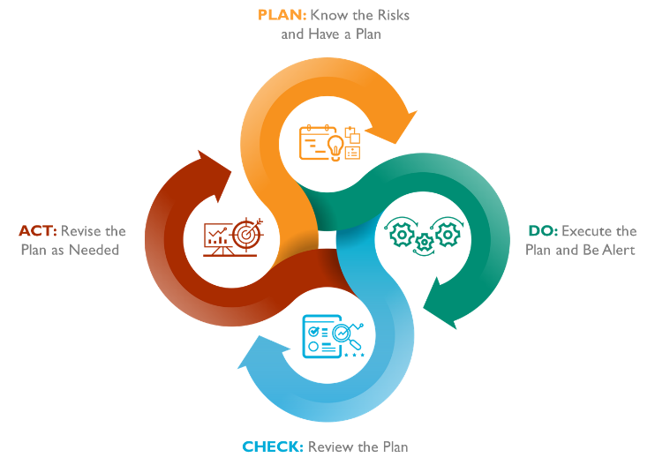
Risk Management Cycle
Notes:
The risk-management cycle is often referred to as “plan-do-check-act” (PDCA) and is depicted here. Managing transport risks begins with the commitment of the leaders involved, demonstrated by dedicating financial and other resources to ensure the following:
PLAN: Risks (hazards, threats, and consequences) are identified, assessed, and understood.
DO: Appropriate risk-control measures (e.g., equipment, policies, procedures, and personal protective equipment (PPE)) are provided.
CHECK: Control measures are functioning as intended.
ACT: Improvement measures (e.g., training, exercises, auditing, learning from experiences, and incident investigation) are practised.
Senders, logistics providers, and drivers (corporate or independent) all have a role to play in managing transport safety and security risks. A risk-management plan should be developed, ideally in collaboration with all relevant parties, to clarify and communicate respective roles and responsibilities. Communication between all those involved is essential for the plan to be workable and effective, particularly because unforeseen situations, such as road closures, weather events, equipment breakdowns, terrorism, or crime, may require flexible responses to maintain safety and security.

Slide 34
General Transport Management
Sender
The sender should have a structured and systematic approach to establish roles and responsibilities for safe and secure shipping of hazardous chemicals.
Logistics
Provider
The logistics provider should have a structure for staff development to build capacity. They should also have clear work process and operation procedures.
Driver
The driver should be familiar with the company operation procedures in relation to transporting of hazardous good.
Notes:
Management systems describe company structures and how those companies systematically execute their work in order to ensure optimum results. Generally, companies follow the PDCA cycle on the previous slide. Senders and logistics providers should set contractual and other provisions that ensure that:
Roles and responsibilities are clearly defined in policies; and
legislation and other requirements (such as those of customers) are adhered to and that the system is regularly reviewed for compliance with such requirements.
Senders, logistics providers, and drivers can use the questions in the OPCW guideline to identify gaps in policies and to define expected roles and responsibilities.
The OPCW guidelines identify 5 general transport management areas. The first area is simply General Transportation Management and as this slide indicates, it addresses the general structures, policies, and procedures for senders, logistics providers, and drivers.

Slide 35
Vehicle Management
Sender
The sender must determine appropriate transport equipment.​
Logistics
Provider
The logistics provider should have procedures in relation to vehicle cleaning, maintenance and inspections. These should be communicated within the organization.
Driver
The driver should familiarize themselves with the procedures in relation to vehicle cleaning, maintenance, and inspection.
Notes:
Vehicle management can include processes that determine the appropriate transport equipment for the products being carried, as well as processes to maintain that equipment.

Slide 36
Journey Management
Sender
The sender should make a risk-based decision about the route chosen and any associated planning requirements.
Logistics
Provider
The logistics provider should assess a proposed route to balance safety and security for a given journey. Pre-departure checklists should be developed to aid the driver to comply with requirements.
Driver
The driver should follow procedures relating to the journey, manage deviations, and report accordingly.
Notes:
Journey management planning starts before a shipment leaves a facility and continues after a shipment is delivered.

Slide 37
Driver Management
Sender
The sender should have a system in place to identify appropriate drivers.
Logistics
Provider
The logistics providers should establish a robust staff training program for safety and security transport of dangerous goods. The training program should include periodic performance reviews and corrective action as necessary.
Driver
The driver should be aware of any training and certification requirements they need to perform their role effectively.
Notes:
Driver management addresses the recruitment/selection process; qualifications; training and development; language capabilities/communication; and expected product knowledge.

Slide 38
Incident Management
Sender
The sender should set expectations for how a driver should behave in the case of a safety or security incident.
Logistics
Provider
The logistics provider should, where necessary, align incident management procedures with any requirements of the sender. Contact number of the sender should be readily accessible in case of an incident.
Driver
The driver should be familiar with and trained in incident management procedures, including the use of incident response equipment and emergency contact numbers.
Notes:
Incident management should set up expectations for what a driver should do in the case of a safety or security incident. In particular, mechanisms for the expected communication with first responders should be established, including the type of hazard information that drivers should carry with them. Examples include SDSs; Transport Emergency (TREM) Cards; emergency response guides; and protocols for shelter-in-place (i.e., staying put until it is safe to move). Finally, establishing post-incident investigation policies will help ensure continuous improvement of transport safety and security.

Slide 39
Introduction to Cyber Security Risks
Notes:
The increasing digitalisation and interconnectivity of transport and logistics systems have made companies and logistics service providers more vulnerable to cyber-attacks. These attacks can lead to serious security problems, such as theft of data, the disruption of transport processes, or the manipulation of vehicles.

Slide 40

Objectives
By the end of this section you will:
Be aware of the cyber security risks that may affect the safe and secure transport of hazardous chemicals;
Resources provided for more information on cyber security risks.
Notes:
In this section, we will review some cyber security concerns and provide resources for further information on how to improve cyber security at your facility.

Slide 41
Cyberattack Techniques and Tactics in Transport
Theft of Data
Transport Disruption
Vehicle Manipulation
Financial Loss
Notes:
There are many known cyber-attack techniques and tactics that can have a significant impact on organisations in the transport industry, for example:
Theft of data: Cybercriminals can penetrate networks and steal confidential information (e.g., customer and business data), which can subsequently be used for criminal purposes, such as identity theft or extortion.
Disruption of transport processes: Cyber-attacks can also cripple information technology (IT) systems, leading to significant delays in the delivery of goods, the diversion of hazardous chemicals, damage to an organisation’s reputation, or unsafe conditions during transport.
Manipulation of vehicles: In some cases, cybercriminals can also penetrate and manipulate vehicles. This can lead to dangerous situations, such as the driver losing control of the vehicle or an intruder tampering with navigation and safety systems.
Financial losses: Cyber-attacks can lead to significant financial losses through theft of funds, loss of business opportunities, or business closure.

Slide 42
Cyber Security Measures
Implementation of:
Security protocols and procedures;
Training employees on cyber security;
Regular review and monitoring risks;
Utilizing threat modelling.
Basic cyber security practices:
1. Backing up their data;
2. Adoption of protective measures against malware;
3. Measures to protect smartphones and tablets;
4. Use passwords to protect data;
5. Measures to avoid phishing attacks;
and
6. Steps to put into place protective measures against ransomware.
Notes:
Organisations should take appropriate measures to protect their data and electronic systems from cyber-attacks. This includes implementing security protocols and procedures, training employees in cyber security, and regularly reviewing and updating security measures. Cyber security plans and actions can be enhanced through threat modelling. Additionally, organisations that develop software related to these areas should adopt secure development practices.
Basic cyber security practices that all stakeholders should adopt include:
- Backing up data;
- Implementing protective measures against malware;
- Protecting smartphones and tablets;
- Using strong passwords to safeguard data;
- Taking measures to avoid phishing attacks; and
- Implementing protective measures against ransomware.

Slide 43
Cyber Security Resources
1. Open Worldwide Application Security Project (OWASP), Software Assurance Maturity Model - https://owasp.org/www-project-samm/
2. Synopsys, Building Security in Maturity Model - https://www.synopsys.com/softwareintegrity/software-security-services/bsimm-maturity-model.html
3. National Institute of Standards and Technology (NIST), Software Supply Chain Security - https://www.nist.gov/system/files/documents/2022/02/04/software-supply-chain-security-guidance-under-EO14028-section-4e.pdf
4. National Cyber Security Centre, Small Business Guide: Cyber Security - https://www.ncsc.gov.uk/collection/small-business-guide
5. National Institute of Standards and Technology (NIST), Protecting Data from Ransomware and Other Data Loss Events - https://www.nccoe.nist.gov/sites/default/files/legacy-files/msp-protecting-data-extended.pdf
6. Guide to Malware Incident Prevention and Handling for Desktops and Laptops, National Institute of Standards and Technology - https://nvlpubs.nist.gov/nistpubs/specialpublications/nist.sp.800-83r1.pdf
7. Guidelines for Managing the Security of Mobile Devices in the Enterprise - https://www.nist.gov/publications/guidelines-managing-security-mob ile-devices-enterprise-0
8. Digital Identity Guidelines - https://pages.nist.gov/00-63-3/sp800-63b.html
9. Temoshok, David et al, Digital Identity Guidelines - https://csrc.nist.gov/pubs/sp/800/63/4/ipd
10. National Cyber Security Centre, A guide to ransomware, https://www.ncsc.gov.uk/ransomware/home.
Notes:
Provided here are cyber security resources that may be useful for your organisation.

Slide 44
Role-Specific Guidance for the Stages of Transport
Notes:
The following slides provide specific guidance for each individual role.

Slide 45
Sender
Hazard Identification
Packaging and Marking
Tanks and Marking
Qualifications and Resources
Documentation
Security Information
Route Selection
Incident Plan and Reporting
Notes:
The correct classification of dangerous goods is an important first step and must be carried out carefully. The subsequent steps, such as the selection of suitable packaging, tanks, equipment, marking and placarding, depend on this classification. If the dangerous goods classification is not correct, this can lead to incorrect selection/decisions in the subsequent processes.
Senders should:
Ensure that the chemical hazards have been identified.
Check with competent authorities to confirm whether goods are covered by national/regional legislation (e.g., transport, export control, security, etc.) and are consistent with best practices for road transit.
Inform the logistics provider about relevant hazards and describe actions to be taken in the event of a chemical release or theft.

Slide 46

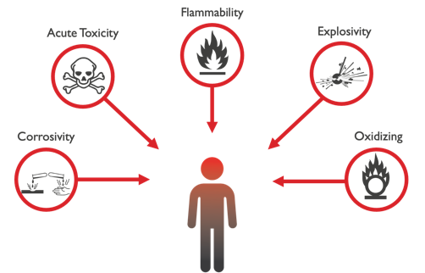
Sender
Preparation
Hazard Identification
Answers the questions:
What are we shipping?
And/or What hazards are inherent to the item?
Is it allowed?
Notes:
The correct classification of dangerous goods is an important first step and must be carried out carefully. The subsequent steps, such as the selection of suitable packaging, tanks, equipment, marking and placarding, depend on this classification. If the dangerous goods classification is not correct, this can lead to incorrect selection/decisions in the subsequent processes.
Senders should:
Ensure that the chemical hazards have been identified.
Check with competent authorities to confirm whether goods are covered by national/regional legislation (e.g., transport, export control, security, etc.) and are consistent with best practices for road transit.
Inform the logistics provider about relevant hazards and describe actions to be taken in the event of a chemical release or theft.

Slide 47
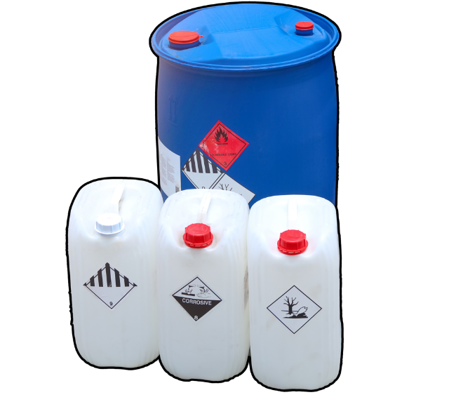
Sender
Preparation
Packaging and Marking
Is the packaging approved, suitable, and properly marked for the chemicals involved?
Notes:
Ensure the instructor explains chemical and container compatibility, as well as load segregation and securing considerations.
Verify that packaging meets regulatory requirements and/or international best practices (see Section 7.2).
Confirm that packaging is compatible with the goods being transported.
Ensure incompatible chemicals are not placed in the same package.
Check that specific vehicle requirements, such as placarding and marking, have been communicated to the logistics provider.

Slide 48
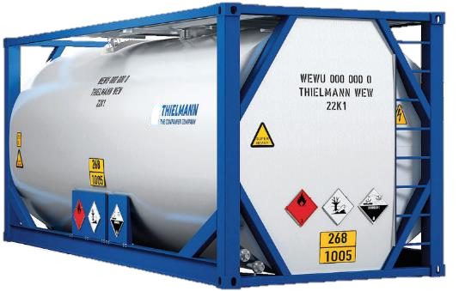
Sender
Preparation
Tanks and Marking
Is the vehicle (e.g. tank/truck) approved, suitable, and properly marked for the chemical it is carrying?
Have the necessary inspections on the vehicle been carried out?

Slide 49


Sender
Preparation
Qualifications and Resources
Have the driver's/company's credentials been confirmed with a comprehensive checklist?
Does the driver possess the proper PPE and/or special equipment necessary to carry out the transport?
Notes:
Understand/verify logistics providers’ safety and security records.
Confirm that necessary driver qualifications have been communicated to contracted companies.
Create a plan or checklist to check driver qualifications on the day of shipment.
The driver must be qualified and the equipment must be suitable for transport.
- Ensure that any specialised equipment or handling has been clearly communicated to the logistics provider.
- Check that specific personal protective equipment (PPE) requirements for onsite work and the work itself are communicated prior to arrival.

Slide 50

Sender
Preparation
Documentation
Has the completion and accuracy of all necessary shipping documents been verified?
Have the documents been provided to the relevant stakeholders?
Notes:
Documentation relevant to what is being transported should be in a language that drivers and emergency responders can understand and should be available throughout the journey.41 Documents may be in paper or digital format. Special safety and security considerations may exist, depending on the chosen format of documents. For example, electronic tablets may present a safety risk as they could be a source of a spark or ignition and may also present cyber security risks.
At a fundamental level, shipping documents should provide:
accurate information about the goods being transported, as required by transport regulations; and
emergency-response information, including telephone numbers and contact information.

Slide 51

Sender
Preparation
Security Information
If shipping a critical asset have the necessary information protection protocols been followed?
Notes:
For "High Consequence Dangerous Goods," route planning and stop details may be subject to risk assessment and security planning, with access to this information restricted.
- Ensure, if involved in route management, that sensitive information (e.g., the route, shipment time and type, and quantities of goods) is controlled and that access to that information is limited.
- Confirm that relevant security requirements have been communicated to the logistics providers.

Slide 52
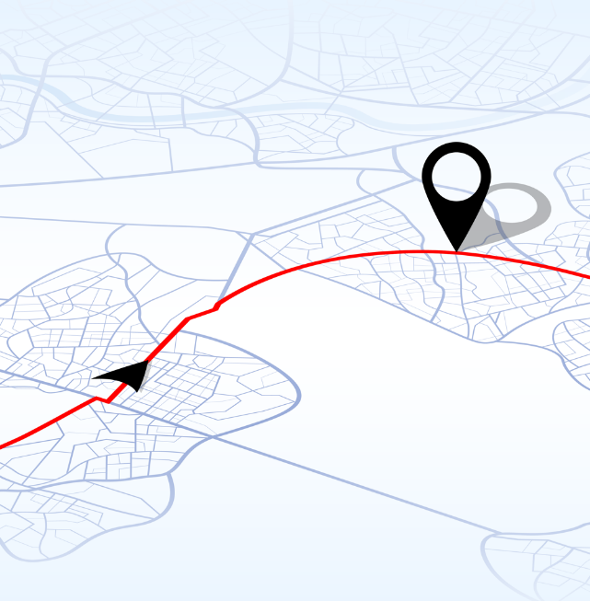
Sender
Preparation
Route Selection
Is the proposed route of transit along approved routes?
Are there any special requirements that need to be considered for the proposed route?
Notes:
- Ensure that regulatory requirements for safety and security along the route are communicated to the logistics provider.
- Check that any specific restriction on dates and time are communicated to the logistics provider.
- Confirm that the logistics provider is aware of when and how frequently the shipments will occur so that the delivery route can be varied as needed.
- Verify whether there are any national requirements for security escorts along part or all of the route and ensure that these requirements are communicated to the logistics provider.
- Update safety and security information periodically.

Slide 53
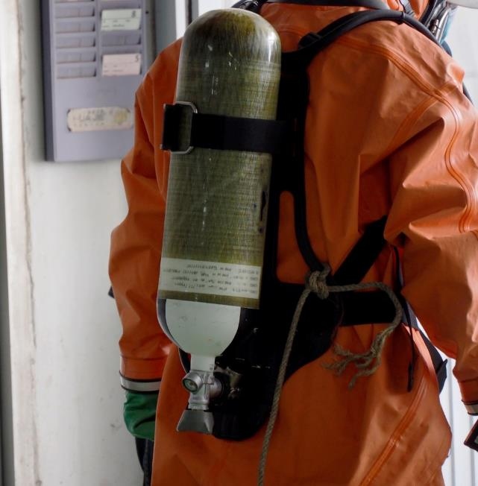
Sender
Preparation
Incident Plan and Reporting
Have emergency management plans been established and communicated in compliance with regulations?
Notes:
If legal regulations on reporting emergencies exist, these must be known and in case followed. Apart from this, there should be processes in place that clearly regulate how to proceed in the event of a transportation incident and the reporting chain should be known.
Ensure that any regulatory requirements for incident reporting are complied with.
Confirm that the incident-reporting plan has been communicated to the logistics provider.

Slide 54

Sender
Preparation
Preparation
Terms and Conditions
Have all parties agreed upon the conditions of the transport?
Notes:
- Ensure that a contract is in place detailing all the relevant terms and conditions of the agreed-upon transport with the logistics provider, including any insurance provisions.
- Confirm who is responsible for any costs incurred for environmental clean-ups in the event of an incident.
- Understand if additional insurance is required due to the value or hazard of the goods.
- Verify that the liability (in the event of an incident) is clearly understood by all parties.

Slide 55



Sender
Loading and Unloading
Plan/Pre-Loading
Has a proper risk assessment been conducted?
Are there written instructions for the process and have they been communicated to the necessary parties?
Notes:
The processes of loading and unloading chemicals share similar risks and risk-management principles.66,67,68,69,70 Loading and unloading may involve transferring hazardous chemicals from tank to tank, from forklift to truck, or from truck to truck. While transferring the chemicals may be a small part of the process, it can pose increased safety and security risks. Risks during these stages can be managed with proper preparation, although additional considerations may be needed for these types of trans-shipments.
Key points:
Qualification of workers, equipment
Safety & security plan
SOPs are available
Roles/responsibilities are clear
Risk assessment
Site-specific requirements
Emergency response plan

Slide 56
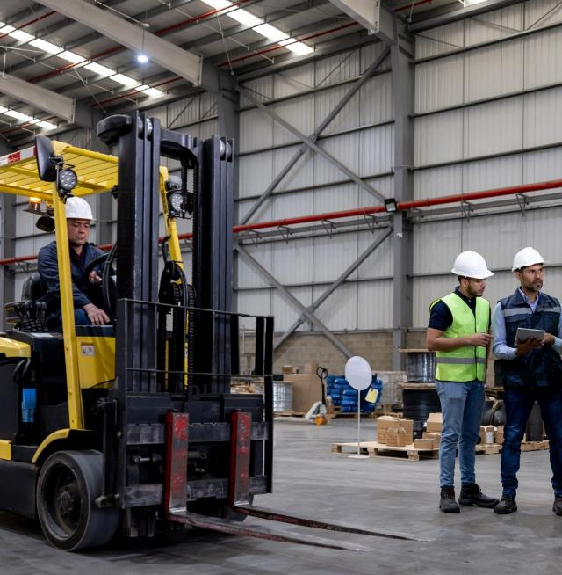
Sender
Loading and Unloading
Equipment and Responsibility
Are the personnel trained on using the equipment, is it provided for their use and is it in proper working order?
Are worker safety protocols in place?
Are relevant SOPs communicated and followed?
Notes:
Verify whether the following have been accomplished:
Loading equipment (e.g., forklifts, cranes) has been approved and provided.
Training has been provided to drivers who come onto the site.
Confirm whether there is a provision for man/machine separation.
Should assume responsibility for, verify, and document who is responsible for loading and unloading chemicals.
Should verify whether the equipment is in good working order.
Understand and verify possible impacts on workers and the surrounding community if an incident were to occur. Senders should also ensure that potential impacts have been communicated with workers and/or relevant members of the community.

Slide 57
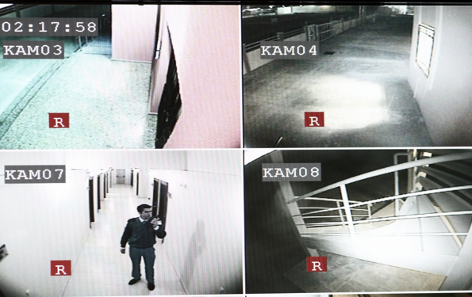
Sender
Loading and Unloading
Loading and Unloading
Insider Threat Considerations
Are there security measures in place to mitigate an insider threat?
Notes:
Criminal acts can be committed or supported by insiders.
The sender should consider how insiders may assist in the theft of chemicals.
The sender should confirm that control measures (e.g., closed-circuit television (CCTV), transfer logs, chains of custody) are used and working.
Control tampering with shipments (e.g., the use of tamper-evident seals).
Determine whether the site has Deter, Detect, Delay, and Respond security features and confirm whether transportation vehicles are included in this plan.

Slide 58
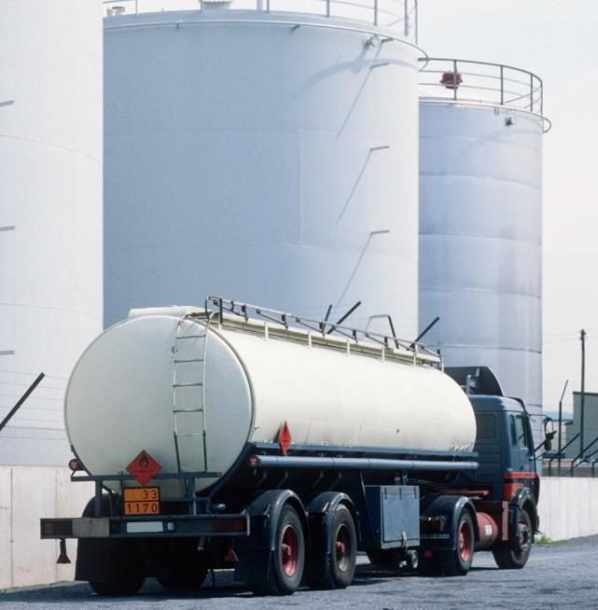
Sender
Driving
Journey Plans
Have you ensured your logistics provider has properly addressed safety and security concerns of the shipment?
Notes:
Hazardous chemicals in motion present distinct safety and security risks. These risks can be reduced through the application of appropriate controls, which include, but are not limited to, qualified drivers, appropriate packaging, and approved routes. Drivers should be alert and follow safety and security plans.
Ensure that logistics providers have a plan to address safety and security concerns.
Confirm that logistics providers are aware of regulatory requirements for safety and security plans.
Request communication from logistics providers in the case of an incident.
Notify, if required, relevant authorities of hazardous materials shipments.

Slide 59

Sender
Stops and Breaks
Planning
Are there safety & security plans in place for stops along the route?
Notes:
Drivers may need to make planned (mandatory) or unplanned stops (e.g., stops necessitated by unforeseen events, such as road closures) along the route. When possible, drivers should park vehicles in locations appropriate for hazardous materials.
Ensure that logistics providers are aware of the need for a safety and/or security plan at all stops.
Ensure that logistics providers are aware of critical human factors (e.g., ergonomics, air conditioning, and rest quality).

Slide 60

Sender
Stops and Breaks
Emergency Response
Has it been ensured that the logistics provider has emergency response plans in place?
Are preparations in place to provide assistance in the event of an emergency on the route?
Notes:
Training in emergency response is a key element to reducing the severity of a chemical incident. Training, including drills and exercises, will reduce/minimise impacts of most
emergency situations. Any emergency response may involve drivers, local first responders, or specialised response personnel.
Must ensure that logistics providers are aware of regulatory requirements relevant to emergency-response capabilities and competencies.
Should mandate that logistics providers inform drivers of safety or security incidents so that continuous learning may take place.
Should be prepared to assist logistics providers in emergency situations.

Slide 61
Logistics Provider
Emergency management
Journey management
Load management
Training
Vehicle maintenance

Slide 62
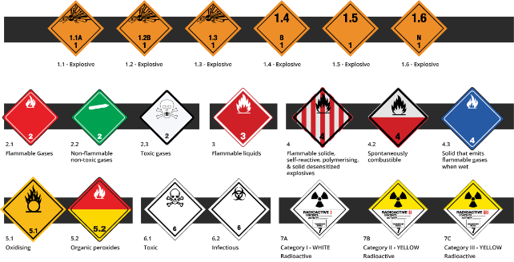
Logistics Provider
Preparation
Hazard Identification
Answers the questions:
What is being shipped?And/or
What hazards are inherent to the item?
Is it allowed?
Ensuring domestic and international legal and regulatory compliance for shipments

Slide 63

Logistics Provider
Preparation
Packing and Marking
Is there a need to mark the vehicle?
Are there chemicals that could react together in the load?
Segregation

Slide 64
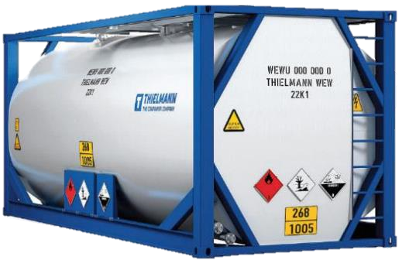
Logistics Provider
Preparation
Tanks and Marking
Does the vehicle require hazard identification to be applied
Does the load require specialist equipment to be carried
Is the vehicle maintenance up to date

Slide 65

Logistics Provider
Preparation
Qualifications
Does the load require specialist drivers and is their training up to date?
Does the driver have the necessary qualifications, skills, background, and resources to operate vehicle and equipment?
Notes:
Understand/verify logistics providers’ safety and security records.
Confirm that necessary driver qualifications have been communicated to contracted companies.
Create a plan or checklist to check driver qualifications on the day of shipment.
The driver must be qualified and the equipment must be suitable for transportation.
Ensure that any specialised equipment or handling has been clearly communicated to the logistics provider.
Check that specific personal protective equipment (PPE) requirements for onsite work and the work itself are communicated prior to arrival.

Slide 66

Logistics Provider
Preparation
Resources
The driver(s) should have all the necessary equipment for the load;
Appropriate first-aid and spill-containment kits should be available;
Safety equipment should be suitable for the employee and support any specific cultural needs.
Notes:
Photo source: Getty Images

Slide 67

Logistics Provider
Preparation
Security Information
All sensitive information should be kept secure;
Drivers should be provided only with relevant security information and be provided with a point of contact to discuss concerns.
Notes:
Photo source: Getty Images

Slide 68
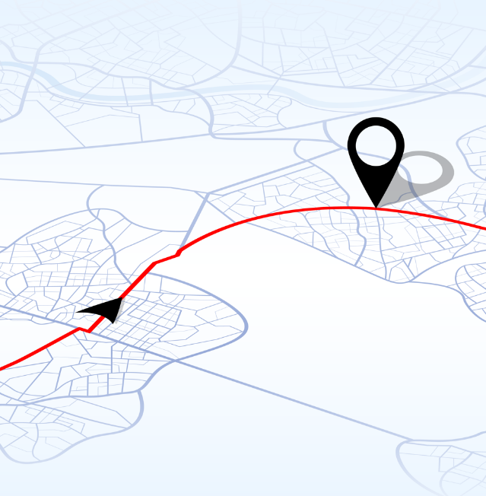
Logistics Provider
Preparation
Route Selection
Does the load require a specific route?
If so has the proposed route been checked for:
  Safety, security, and regulatory compliance
  Infrastructure suitability
  Suitability for the frequency of deliveries
Has the driver been provided with the route details and the relevant documentation?
Are security escorts necessary for all or parts of the journey?
Is GPS tracking available and suitable?

Slide 69
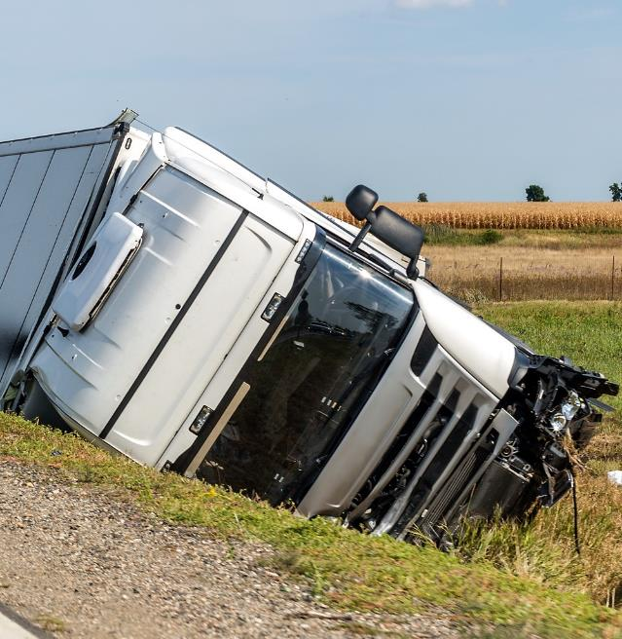
Logistics Provider
Preparation
Incident Planning and Reporting
Are there regulatory requirements for reporting incidents to authorities along the route;
Has an incident-response plan been developed and communicated to all relevant parties.

Slide 70

Logistics Provider
Preparation
Terms and Conditions
Have terms and conditions of carriage been agreed with the sender?
Verify that the liability (in the event of an incident) is clearly understood by all parties;
Is adequate insurance provision in place for the load and has it been communicated?
Notes:
Ensure that a contract is in place detailing all the relevant terms and conditions of the agreed upon transport with the logistics provider, including any insurance provisions.
Confirm who is responsible for any costs incurred for environmental clean-ups in the event of an incident.
Understand if additional insurance is required due to the value or hazard of the goods.
Verify that the liability (in the event of an incident) is clearly understood by all parties.

Slide 71
Logistics Provider
Loading and Unloading
Plan and Preloading
Who will be responsible for the loading and unloading operations?
Is appropriate equipment provided or available to undertake the operation in a safe and secure manner?
  At the loading and unloading site
  In case of an emergency incident
Is the driver aware of their role and obligations?
  Use of PPE
  Site restrictions
  parking
Who is responsible in case of an emergency incident?

Slide 72
Logistics Provider
Loading and Unloading
Equipment
Is the correct equipment being used for the process?
  Is the use of substitute adapters allowed?
Are employees trained and competent for the task?
Systems should be in place to prevent incompatible chemicals from entering the same transportation vessel or storage tank?

Slide 73

Logistics Provider
Loading and Unloading
Responsibility
Who is responsible for loading chemicals?
Confirm that all operators are trained and adequately insured;
Check that equipment is in working order;
Understand possible impacts to workers and surrounding community if an incident occurs and ensure that potential impacts have been communicated to the drivers.

Slide 74
Logistics Provider
Loading and Unloading
Insiders
Consider how insiders may assist in the theft of chemicals;
Verify CCTV, transfer logs, chains of custody are used and working;
Control tampering with shipments (e.g., tamper-evident seals).

Slide 75
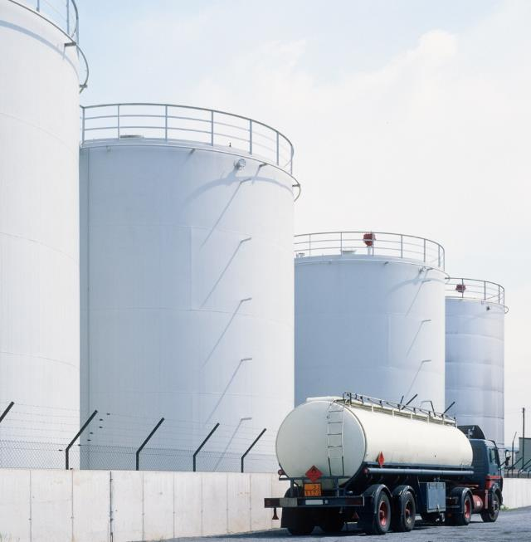
Logistics Provider
Driving
Journey Plans
Are systems in place to:
Inform personnel of security requirements;
Allow the driver to communicate with HQ in case of concerns;
Allow HQ to communicate with drivers if conditions change.
Notes:
Hazardous chemicals in motion present distinct safety and security risks. These risks can be reduced through the application of appropriate controls, which include, but are not limited to, qualified drivers, appropriate packaging, and approved routes. Drivers should be alert and follow safety and security plans.
Ensure that logistics providers have a plan to address safety and security concerns.
Confirm that logistics providers are aware of regulatory requirements for safety and security plans.
Request communication from logistics providers in the case of an incident.
Notify, if required, relevant authorities of hazardous materials shipments.

Slide 76

Logistics Provider
Stops and Breaks
Planning
Stops and breaks along a route should be planned;
Each stop should be assessed to determine suitability;
Consider whether any sites have a history of accidents or security breaches.

Slide 77

Logistics Provider
Stops and Breaks
Reducing Error and Improving Performance
Plan stops along routes taking into account reasonable driving durations and select route segments that comply with regulations on driving shift times

Slide 78
Logistics Provider
Stops and Breaks
Emergency Response
Plan what to do should a vehicle be diverted or need an unplanned stop;
Develop a notification process for identifying unplanned stops;
Train drivers on how to respond to potential safety or security incidents.

Slide 79
Driver
Hazard Identification
Packaging and Marking
Tanks and Marking
Qualifications and Resources
Documentation
Security Information
Route Selection and Journey Plans
Contract Terms and Conditions
Equipment
Drivers and Responsibilities
Incident Plan and Reporting

Slide 80

Driver
PREPARATION
Preparation
HAZARD IDENTIFICATION
Be aware of the hazards of the goods to be carried;
Request chemical-hazard information in a language you can understand;
Be aware of any actions you should take in the event of a chemical release or theft.
Notes:
Photo source: Getty Images

Slide 81
Driver
PREPARATION
Preparation
PACKAGING AND MARKING
What hazard identification is required on the vehicle?
Should some of the products be segregated from each other?
Has the load been secured?
Damaged and leaking packages must not be loaded onto the vehicle; and
The vehicle must not be overloaded.
Notes:
Photo Source: Getty Images

Slide 82
Driver
PREPARATION
Preparation
TANKS AND MARKING
Any necessary markings and placards should be affixed to the vehicle;
Assistance should be made available to emergency services in the event of an incident or accident.

Slide 83
Driver
PREPARATION
Preparation
QUALIFICATION
Complete necessary training and acquire the qualifications to carry specific types of hazardous chemicals;
Ensure that all necessary training and certifications are kept up-to-date.
Notes:
Comply with national legislative provisions, such as:
a. driving hours
b. speed limits
c. security provisions
d. stops and parking
e. licence validity
f. no use of drugs or alcohol.

Slide 84
Driver
PREPARATION
Preparation
RESOURCES
Understand how and when to use safety and security equipment;
Know how to use any supplied spill-containment kits;
Ensure safety equipment is in good working condition.

Slide 85
Driver
PREPARATION
Preparation
SECURITY INFORMATION
Understand how to protect a shipment from security threats;
Understand information security needs and follow the security plan.

Slide 86
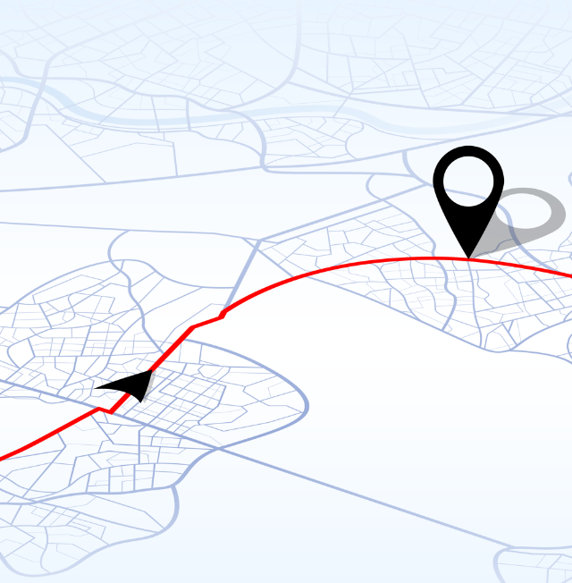
Driver
PREPARATION
Preparation
ROUTE SELECTION
Communicate concerns about routes to supervisors;
Follow specific route requirements provided;
Ensure that any deviations before and during transit are communicated and approved;
Protect information related to security escorts.

Slide 87

Driver
PREPARATION
Preparation
INCIDENT PLANNING AND REPORTING
Know how to act in case of an incident;
Record details of actions to help review incident management.

Slide 88

Driver
PREPARATION
Preparation
TERMS AND CONDITIONS
Know the correct delivery address and any specific limitations in terms of arrival times
Confirm whom to call in the event of a delay in delivery or a safety or security incident

Slide 89
Driver
LOADING AND UNLOADING
Loading and Unloading
PLANNING AND PRELOADING
Request a checklist to assist with safety and security protocols during loading and unloading;
Confirm appropriate documentation (e.g., bill of loading, SDS) are readily available.

Slide 90
Driver
LOADING AND UNLOADING
PLANNING and PRELOADING
Drivers should:
  Confirm equipment is suitable and safe for use;
  Have been trained on how to safely load and unload chemicals;
  Know and understand site-specific requirements including which areas they can and cannot access at the sender’s facility;
  Know where to stay during loading and unloading;
  Know how to verify that the correct material is being loaded and unloaded;
  Inspection of a vehicle before leaving, confirming that hoses, platforms, lifelines, and wheel chocks have all been properly removed.
Loading and Unloading

Slide 91
Driver
LOADING AND UNLOADING
Loading and Unloading
EQUIPMENT
Check that appropriate PPE and spill kits are available and ready;
Inspect equipment while loading and unloading to ensure it is in good working condition;
Raise concerns if issues or suspicions arise;
Know how to operate all necessary equipment related to their job roles.

Slide 92
Driver
LOADING AND UNLOADING
Loading and Unloading
RESPONSIBILITY
Should check what damages they may be liable for if an incident occurs during loading or unloading;
Should understand the possible outcomes on themselves, on other workers, and the surrounding environment if a release or theft were to occur;
Ensure that they are sufficiently rested so that they are alert and able to drive after loading or unloading, and that they are fit enough to comply with company standards or legal codes in the countries where they operate.

Slide 93
Driver
LOADING AND UNLOADING
Loading and Unloading
INSIDERS
Document chain of custody and operate security measures (e.g., tamper-evident indicators)

Slide 94
Driver
DRIVING
Driving
JOURNEY PLANS
Before departure, ensure:
  The vehicle is fit for purpose;
  Equipment is appropriate;
  Shipping documentation is accessible;
  The load is secure and undamaged;
  The route to be taken is known;
  The driver is rested and fit to drive;
  The driver is briefed on current safety and security concerns;
  Emergency equipment is readily accessible.

Slide 95
Driver
STOPS/BREAKS
Stops and Breaks
PLANNING
Know the approved stops and where to park;
Secure the vehicle when vehicle is not in the line of vision.

Slide 96
Driver
STOPS/BREAKS
Stops and Breaks
REDUCING ERRORS AND IMPROVING PERFORMANCE
Inform supervisors of any personal safety or wellbeing concerns at stops.
Express any concerns related to securing the vehicle and the product at stops with your supervisor;
Express any concerns about manoeuvring the vehicle safely in busy areas.

Slide 97
Driver
STOPS/BREAKS
Stops and Breaks
EMERGENCY RESPONSE
Relevant safety incidents (e.g., a tyre puncture or an accident) should be responded to appropriately;
It should be ascertained that appropriate behaviour and response can be demonstrated during relevant security incidents (e.g., hijackings);
The appropriate contact person should be known in case of an emergency;
Communication should be maintained at all locations along the route, as necessary.

Slide 98
Acknowledgement
Brenntag UK Limited
Brenntag UK Limited
Brenntag UK Limited
The training materials were developed as the result of Indicative Guidelines for Safe and Secure Transport of Hazardous Chemicals by Road, in 2024.
The workshop benefited from the participation of the following experts:
Dougl Leech (Brenntag UK Limited)
Robert Schmidkunz (Evonik Operations GmbH)
Mirvat Abdelhaq (Global Chemical and Biological Security/ Sandia National Laboratories)
Mary Beth Mulcahy (Global Chemical and Biological Security/ Sandia National Laboratories)
Mo Payne (Global Chemical and Biological Security/ Sandia National Laboratories)
Christine Straut Langlinais (Global Chemical and Biological Security/ Sandia National Laboratories)

